Slide 1
Module 3: Lesson 6 MapReduce Optimization

Slide 2
MapReduce Optimizations
General Principle: Do more work in mappers
Push as much computation as possible to the mappers as they operate with the greatest degree of parallelism and leverage the most cluster resources
General Principle: Decrease traffic across the network
Reduce the amount of data that must be exchanged among nodes
General Principle: Synergies of Optimization
Doing more work in mappers can, in many cases, lead to reduced network traffic

Slide 3
Combiner
The combiner acts as an optional localized reducer
It performs a partial aggregation of intermediate key-value pairs generated by the mapper
This helps to minimize data transfer (network overhead) between mapper and reducer
It also decreases the amount of work needed to be done by the reducer

Slide 4
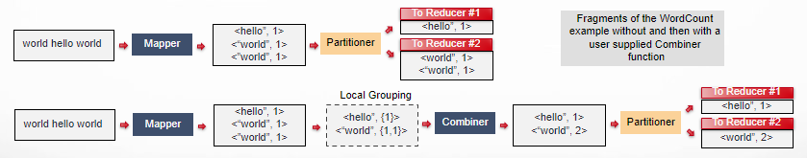
Combiner
Takes the intermediate keys from the mapper and applies an (optional) user-provided method to aggregate values in the scope of one mapper
Sending <“world”, 2> to the reducer…
Decreases the number of bytes sent across the network
Decreased the computational load on the reducer

Slide 5
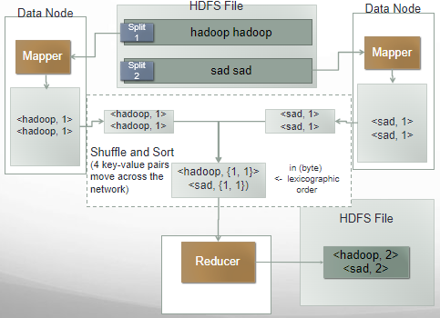
WordCount without Using a Combiner In More Detail
from mrjob.job import MRJob
import re
WORD_RE = re.compile(r"[\w']+")
class MRWordCount(MRJob):
def mapper(self, _, line):
for word in WORD_RE.findall(line):
yield (word.lower(), 1)
def reducer(self, word, counts):
yield (word, sum(counts))
if __name__ == '__main__':
MRWordCount.run()

Slide 6
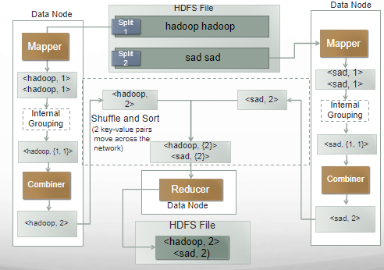
WordCount with Using a Combiner In More Detail

Slide 7
WordCount with Using a Combiner In More Detail
from mrjob.job import MRJob
import re
WORD_RE = re.compile(r"[\w']+")
class MRWordCount(MRJob):
def mapper(self, _, line):
for word in WORD_RE.findall(line):
yield (word.lower(), 1)
# optimization: sum the words we've seen so far
def combiner(self, word, counts):
yield (word, sum(counts))
def reducer(self, word, counts):
yield (word, sum(counts))
if __name__ == '__main__':
MRWordCount.run()
A combiner only aggregates data output by one mapper task operating on one split
The output of the combiner must be the same format as that of the Mapper
<key, value>
AND NOT
<key, {value1, value2, …}>

Slide 8
When Might a Combiner Execute?
The MapReduce framework does not guarantee how many times a combiner will be invoked for a given key-value pair
It may be called zero times, once, or multiple times and therefore a combiner must be able to handle any of these scenarios
Combiners should be designed to be idempotent, meaning that applying the combiner function multiple times to the same input should produce the same result as applying it once
This property ensures that even if the same key-value pairs are presented to the combiner multiple times, the final result remains consistent
Some operations, such as summation or counting, are naturally idempotent and can be safely applied multiple times.
However, more complex aggregation functions may require careful consideration to ensure correctness.

Slide 9
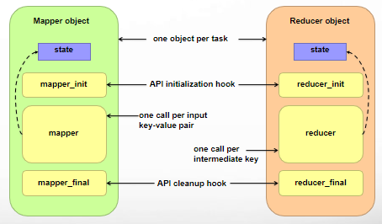
Local Mapper and Reducer State
Mappers or Reducers with local state can retain and use information across invocations for the same key and perform in-memory computation
Local state leverages temporary storage within the mapper or reducer node, and allows for efficient computation of intermediate results.
By remembering past values, local state facilitates sophisticated aggregations like filtering, sorting, and statistical calculations
Local state involves a trade-off with increased complexity and potential memory overhead versus richer analysis and better performance

Slide 10
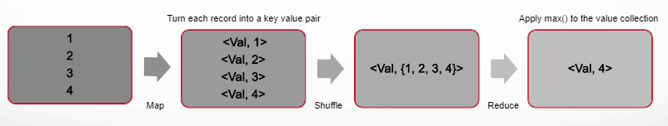
Find the Maximum Value without Local State
Calculate the maximum in the Reducer

Slide 11
Find the Maximum Value without Local State
Calculate the maximum in the Reducer
from mrjob.job import MRJob
class GlobalMax(MRJob):
def mapper(self, _, line):
yield “Val”, int(line)
def reducer(self, key, values):
yield key, max(values)
if __name__ == '__main__':
GlobalMax.run()
The Mapper parses the input but delegates calculation to the Reducer. The Mapper retains no state between iterations (executions).
Uses the Python max() function

Slide 12
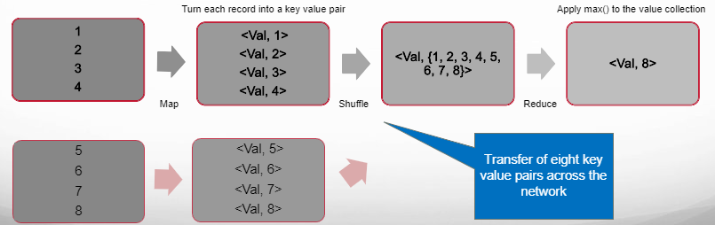
Find the Maximum Value without Local State
If we have a lot of nodes, that's a lot of data moving...

Slide 13
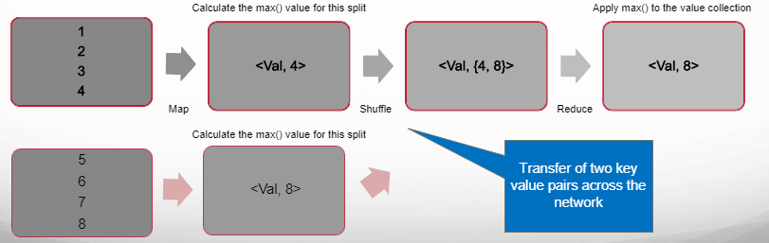
Value with Find the Maximum Local State
Implement calculation in both the Mapper and Reducer…

Slide 14
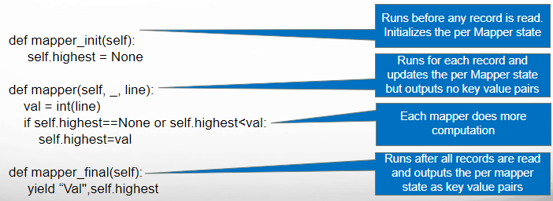
Find the Maximum Value with Local State
Implement calculation in both the Mapper and Reducer…

Slide 15

Find the Maximum Value with Local State
Implement calculation in both the Mapper and Reducer…

Slide 16
Using Local State Optimization
Local state is a powerful tool in the MapReduce toolbox, but its effectiveness depends on your specific data, analysis needs, algorithm complexity, and resource constraints
Analyze the trade-offs and choose this approach for your job where the performance improvements are worth the additional complexity and resource use

Slide 17
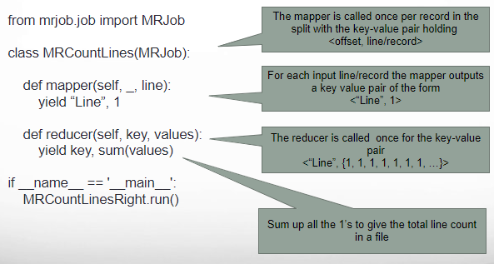
Count the Number of Lines (Records) in a Dataset No Optimizations

Slide 18
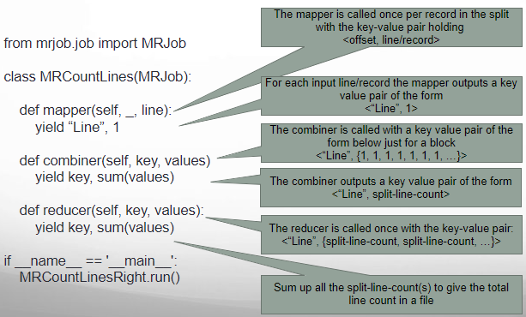
Count the Number of Lines (Records) in a Dataset Uses a Combiner

Slide 19
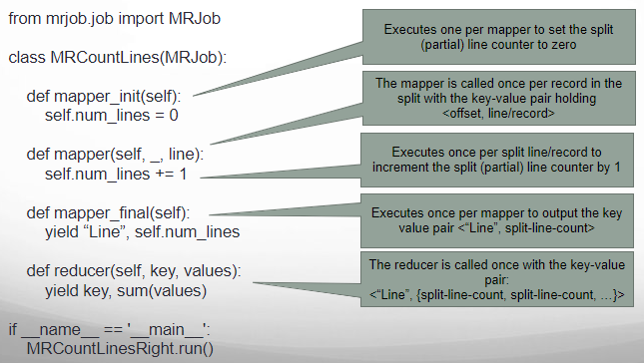
Count the Number of Lines (Records) in a Dataset Uses Local State Optimization

